Slide 1
CODE ESCAPE
Ernie Ledezma, Dani Odicho, Tariq Rafiq, Joseph Peña, Abel Lawal, Oscar Lugo, Jose Pech, Kasun Hettiarachchi

Slide 2
Vision Statement
First-Person Educational Game
Teaches basics of Java programming
Accomplishes this through Puzzles

Slide 3






Tools
Unity
Monodevelop
Blender
Photoshop
Github
Google Drive

Slide 4
Puzzles Completed:
Hello world (Print-out)
Ints and doubles
Indentation
Input Scanner
Random number generation
If statements
While loops
For loops
Arrays
Methods

Slide 5
Accomplishments
Learned Unity, C#, Blender
Completed 4 Puzzles
Working Together as a Team
Making the Game Scary Because REASONS

Slide 6
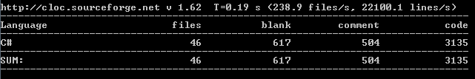
Source Lines of Code
Scripting - 3135 lines
Generated Code - 26534 lines

Slide 7
Use Case Diagram
Enter Next Room
Read puzzle material
Read and modify code
Solve Puzzle
Interact with room objects
student

Slide 8
Software Architecture (MVC)
Model
(classes - data - game states)
View
(scene - UI - blender models)
Controller
( C# scripts)

Slide 9
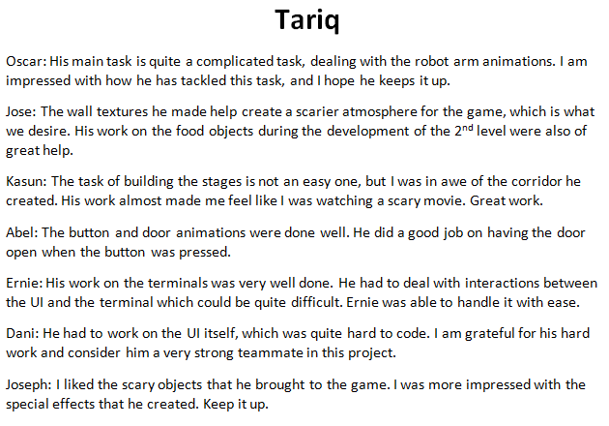
Peer Review

Slide 10
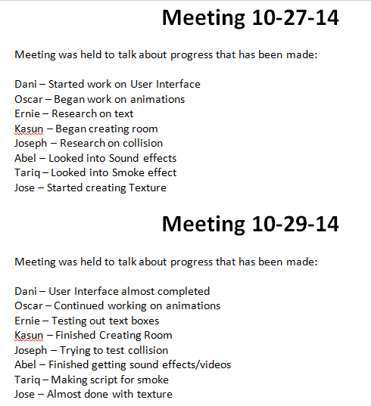

Meeting Notes

Slide 11
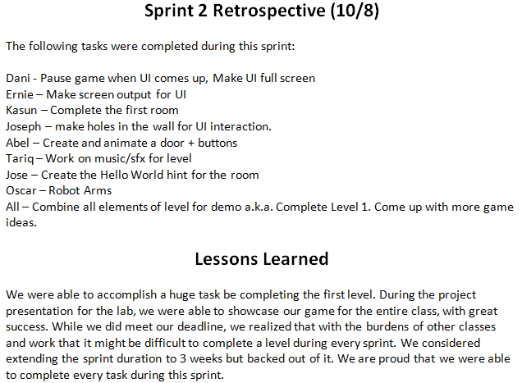
Sprint Retrospective

Slide 12
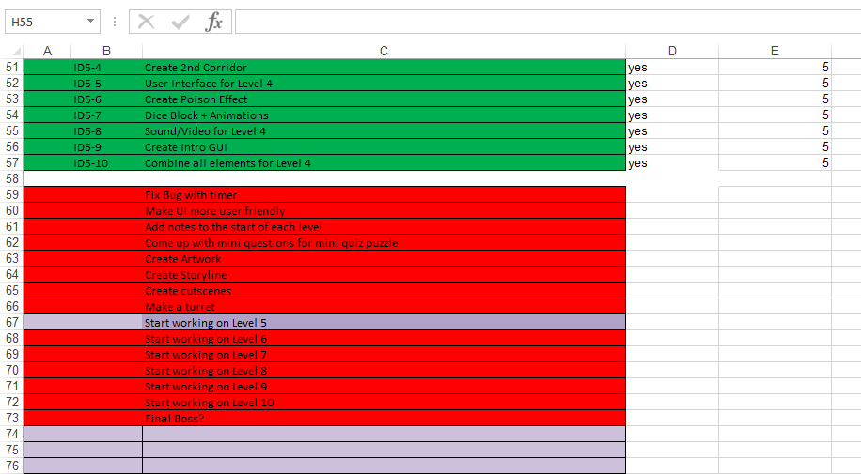
Product Backlog

Slide 13
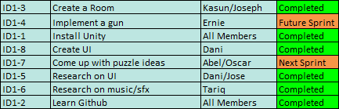
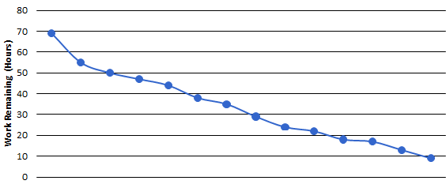
Sprint 1

Slide 14
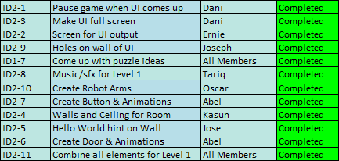
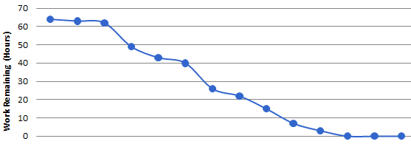
Sprint 2

Slide 15
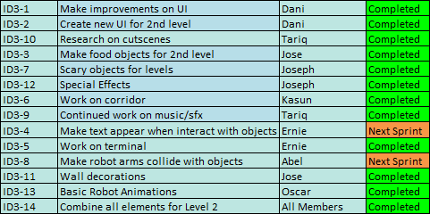
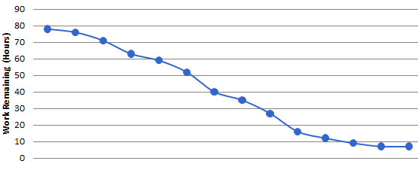
Sprint 3

Slide 16
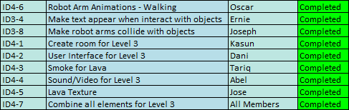
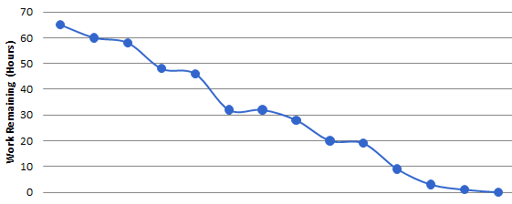
Sprint 4

Slide 17
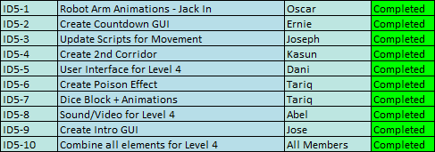
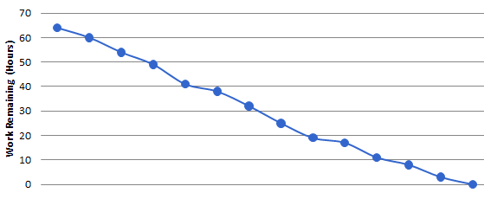
Sprint 5

Slide 18
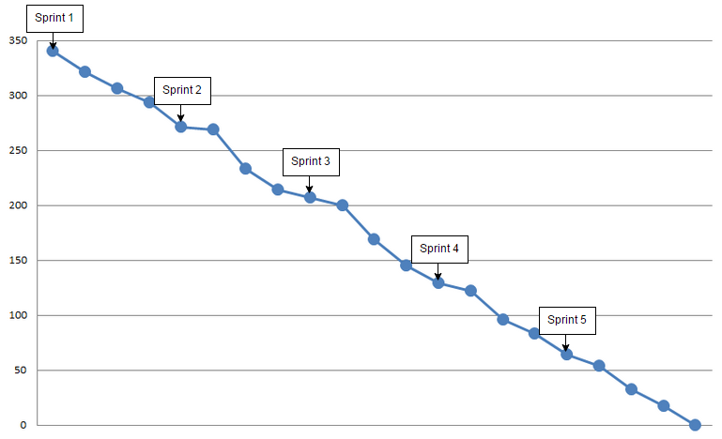
Semester Burndown

Slide 19
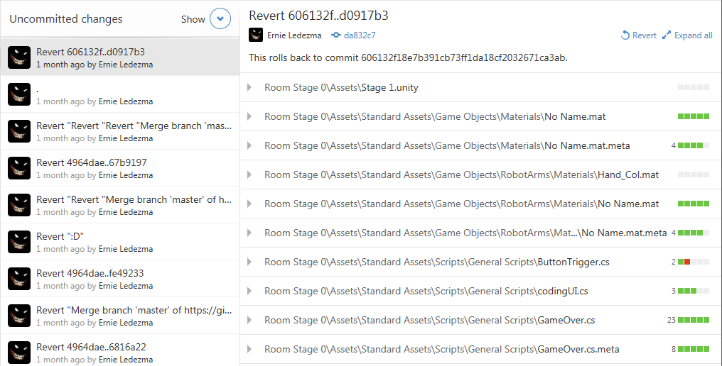
Github

Slide 20
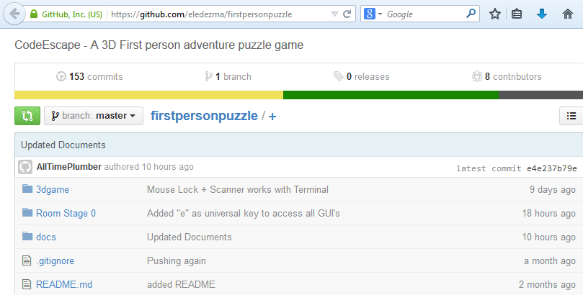
PAL https://github.com/eledezma/CodeEscape

Slide 21
User Stories
As a User(of the game, of course):
I will be able to control character movement and vision
I will be able to interact with objects in the room (ex: JACK IN!)
I will be able to look, assess, and modify Java code at level terminals
I will be able to retry the level if I should(and I shouldn’t) fail
I will be scared

Slide 22
What Worked Well
Organization:2 Product Owners, 1 Scrum Master, 8 Developers
Scrum Master: Tariq was born for this role. He worked in close conjunction with the product owners to make sure that every sprint had clear goals and everyone knew their tasks.

Slide 23
What Worked Well
TeamWork: Probably the greatest strength of Team CodeEscape is our teamwork. Many of us have been friends for years so our communication was frank, clear and concise. Our “wingstop meetings” were informal but very productive, Some of the most important decisions were conceived over chicken.
The Agile Methodology

Slide 24
What Didn’t Work Well
Github
Scene Merge Issues
The Epic Revert of 2014
Robot Arms
Creative Differences

Slide 25
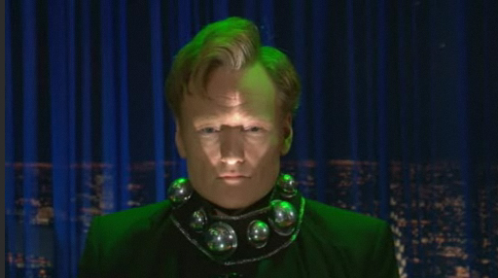
Future Plans

Slide 26
Future Plans
We have big plans for next semester:
More Levels/Puzzles
Improving visuals (maps, characters, textures etc)
Cutscenes
Informative intro scenes and quiz outro scenes.
Menu Screens
Voice Acting

Slide 27

Questions

Slide 28

Game Demo Time

